Slide 1
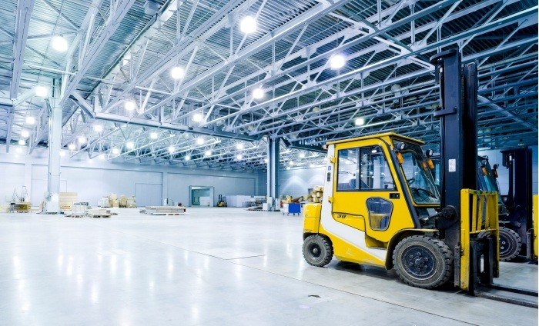
Lecture 11-Lean Manufacturing, 6 sigma and Reliability Theory

Slide 2
Lean Manufacturing
Lean manufacturing or lean production, often simply "lean", is a systematic method for the elimination of waste (non-value adding steps) within a manufacturing system
The Lean approach is based on finding and removing wasteful steps that don't add value to the end product

Slide 3
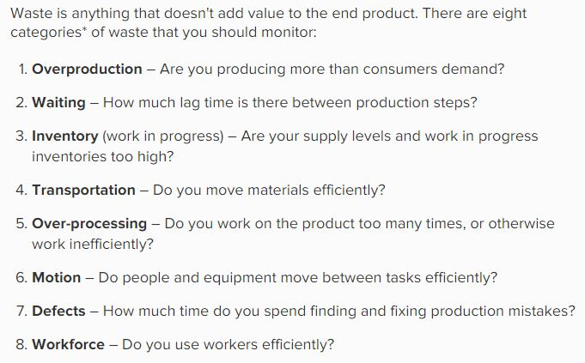
Types of Wastes

Slide 4
Push System and Pull System
Push System: The push system of inventory control involves forecasting inventory needs to meet customer demand. Companies must predict which products customers will purchase along with determining what quantity of goods will be purchased. The company will in turn produce enough product to meet the forecast demand and sell, or push, the goods to the consumer.
Disadvantages of the push inventory control system are that forecasts are often inaccurate as sales can be unpredictable and vary from one year to the next. Another problem with push inventory control systems is that if too much product is left in inventory. This increases the company's costs for storing these goods.
An advantage to the push system is that the company is fairly assured it will have enough product on hand to complete customer orders, preventing the inability to meet customer demand for the product.

Slide 5
Push System and Pull System
Pull System: The pull inventory control system begins with a customer's order. With this strategy, companies only make enough product to fulfill customer's orders.
One advantage to the system is that there will be no excess of inventory that needs to be stored, thus reducing inventory levels and the cost of carrying and storing goods.
However, one major disadvantage to the pull system is that it is highly possible to run into ordering dilemmas, such as a supplier not being able to get a shipment out on time. This leaves the company unable to fulfill the order and contributes to customer dissatisfaction. An example of a pull inventory control system is the just-in-time, or JIT system. The goal is to keep inventory levels to a minimum by only having enough inventory, not more or less, to meet customer demand. The JIT system eliminates waste by reducing the amount of storage space needed for inventory and the costs of storing goods.

Slide 6
Tools to Reduce Waste (Tools to implement LEAN)
Just In Time (JIT) production system
Kanban
Zero Defects :
This system focuses on getting the product right the first time, rather than spending extra time and money fixing poor-quality products.
Single Minute Exchange of Dies (SMED)
5S philosophy (Sort, Set in order, Shine, Standardize, Sustain)

Slide 7


Just In Time (JIT) production system
Just-in-time (JIT) manufacturing is a production model in which items are created to meet demand, not created in surplus or in advance of need. The purpose of JIT production is to avoid the waste associated with overproduction, waiting and excess inventory- 3 of the 7 waste categories defined in the Toyota Production System

Slide 8
JIT in practice
Toyota uses just-in-time inventory controls as part of its business model. Toyota sends off orders for parts only when it receives new orders from customers. The company started this method in the 1970s, and it took more than 15 years to perfect. Several elements of just-in-time manufacturing need to occur for Toyota to succeed. The company must have steady production, high-quality workmanship, no machine breakdowns at the plant, reliable suppliers and quick ways to assemble machines that put together vehicles.

Slide 9
KANBAN
Kanban was developed as a means of fulfilling a just-in-time (JIT) inventory system. By implementing kanban, materials and supplies arrive right when they are needed. This decreases storage and carrying costs.
The term 'kanban' combines the Japanese words 'kan' meaning 'visual' and 'ban’, meaning 'card' or 'board‘. A kanban is a visual card or other cue that signals something is needed. It is a "pull" system, where supply is determined by the manufacturer or user.

Slide 10
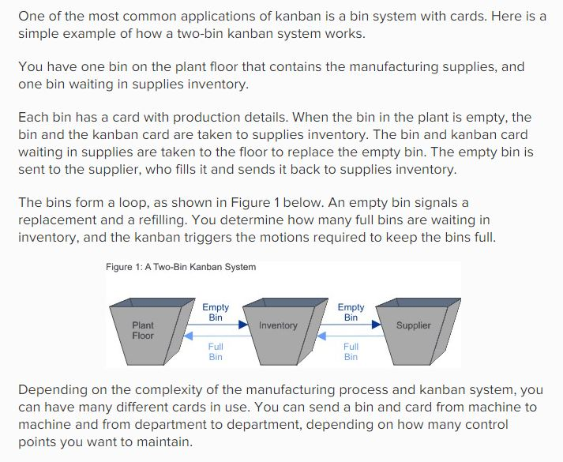

Slide 11
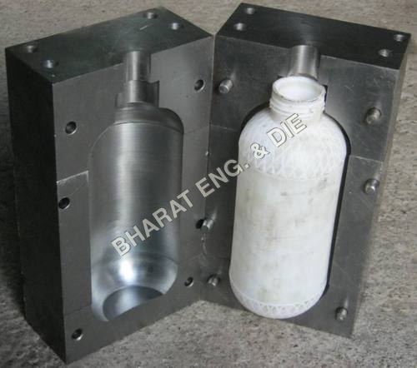
Single Minute Exchange of Dies (SMED)

Slide 12
Single Minute Exchange of Dies (SMED)
This helps to build flexibility into production. For example, in the automotive industry, it could take days to change a line to produce a different car model. With SMED, the assembly process and machinery are designed to support quick and efficient changeovers. (Here, a "die" is a tool used to shape an object or material)

Slide 13
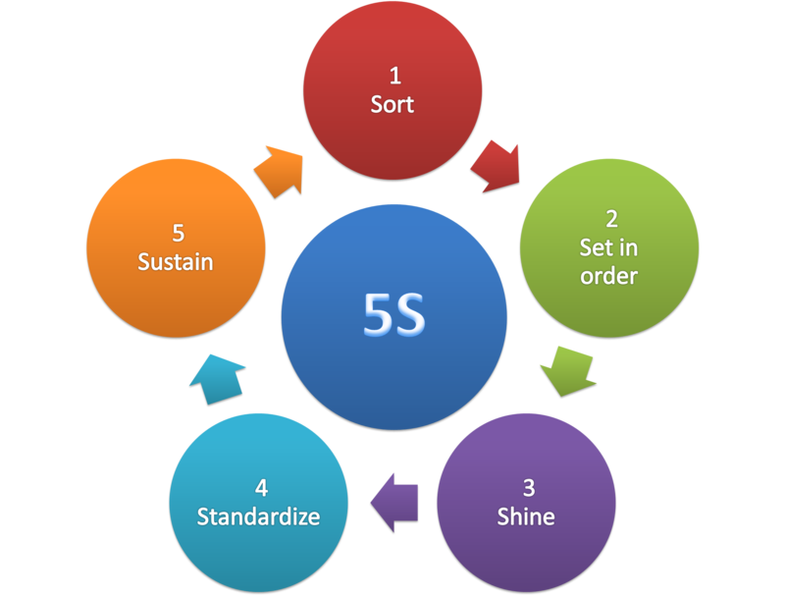
5S Philosophy
5S is a methodical way to organize your workplace and your working practices as well as being an overall philosophy and way of working. It is split into 5 phases, each named after a different Japanese term beginning with the letter “S”; (Seiri, Seiton, Seiso, Seiketsu, Shitsuke) hence the name 5 S. Because of their proven value, they have been translated and restated in English.
Sort—Eliminate whatever is not needed
Set in Order—Organize whatever remains
Shine—Clean the work area
Standardize—Schedule regular cleaning and maintenance
Sustain—Make 5S a way of life

Slide 14


6 Sigma Manufacturing System
Six Sigma is a set of techniques and tools for process improvement. It was introduced by engineer Bill Smith while working at Motorola in 1986. Jack Welch made it central to his business strategy at General Electric in 1995.
Six Sigma seeks to improve the quality of the output of a process by identifying and removing the causes of defects and minimizing variability in manufacturing and business processes.

Slide 15
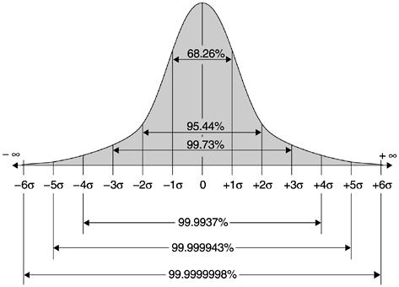
6 Sigma Manufacturing System

Slide 16
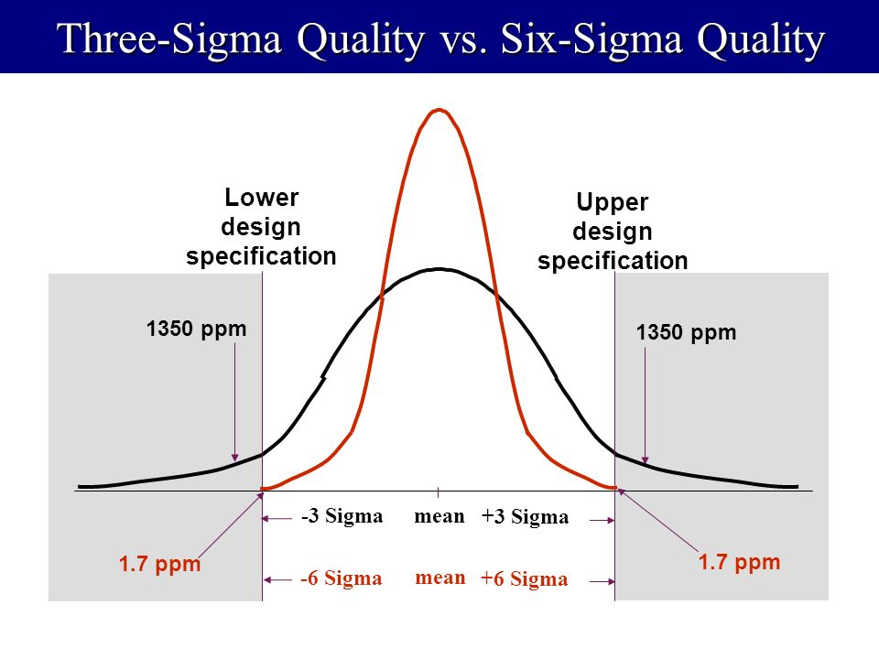
6 Sigma Manufacturing System
For 6sigma process, we find 0.002 defected parts per million by calculating. But it is stated that the defect rate will be 3.4 ppm. This is because the process mean can shift about 1.5 sigma while production is going on which will increase the defect rate.

Slide 17
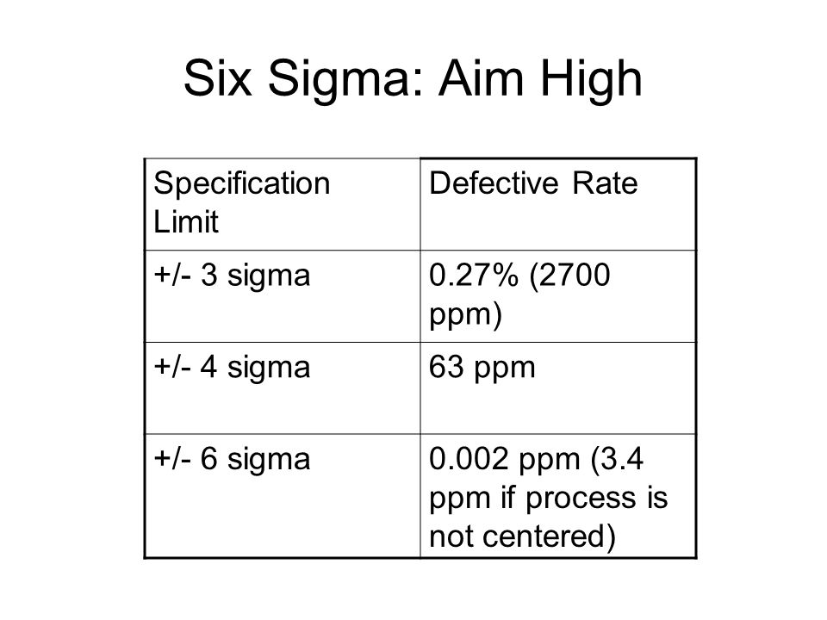
6 Sigma Manufacturing System

Slide 18
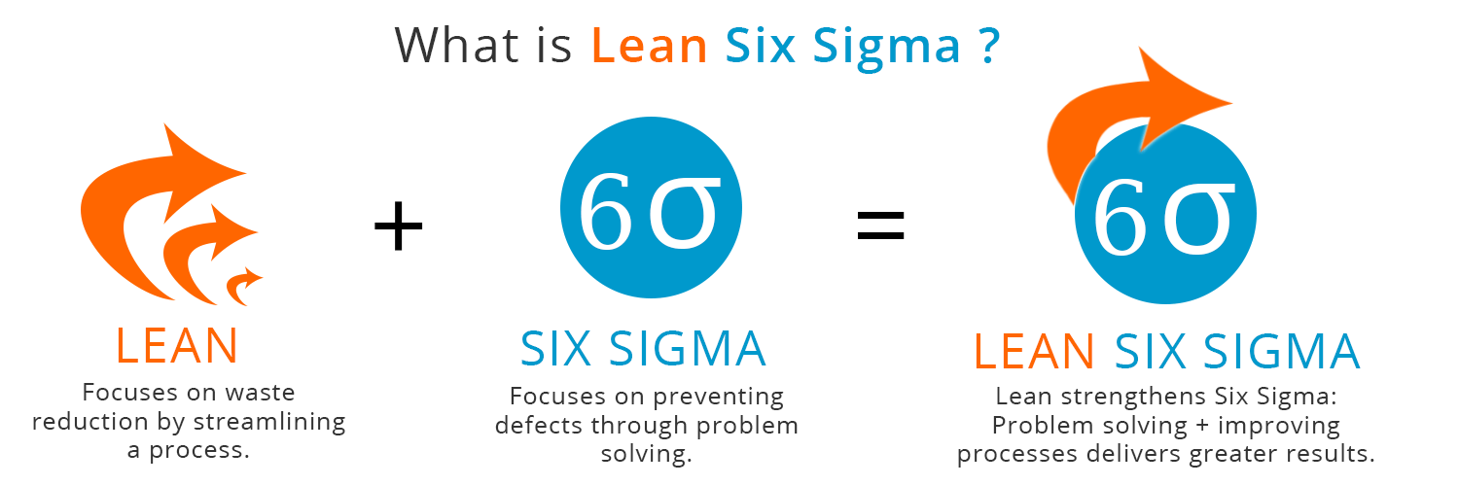
Lean 6 Sigma
Lean Six Sigma was originally created by Motorola whilst looking to increase their productivity by eliminating manufacturing flaws. It has since grown into a business processes management strategy that is known the world over and is used to streamline business processes in virtually every sector.

Slide 19
Reliability Theory
Reliability is the ability of an item to perform a required function under stated condition for a period of time. It is important for company’s reputation, customer satisfaction, warranty cost saving and works as a competitive advantage.
A product is a combination of many component and operating mechanisms. So, a product can be considered as a system which has input, transformation process and creates output.

Slide 20
Types of System
Series System : This is a system in which all the components are in series and they all have to work for the system to work. If one component fails, the system fails.
Parallel System : This is a system that will fail only if they all fail.
Combination System: This is a system where some of the components in series are replicated in parallel

Slide 21

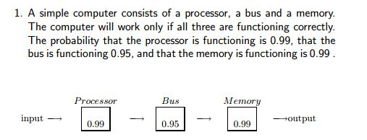
Reliability of Series System
In other words, for a pure series system, the system reliability is equal to the product of the reliabilities of its constituent components.
Find out the probability that the computer will work? (or find the reliability of the system). Ans: 0.8935 or 89.35%

Slide 22

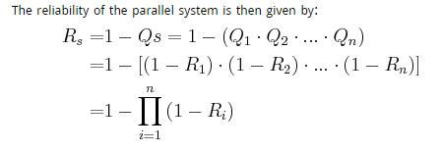
Reliability of a Parallel System
Observe the contrast with the series system, in which the system reliability was the product of the component reliabilities; whereas the parallel system has the overall system unreliability as the product of the component unreliability.

Slide 23
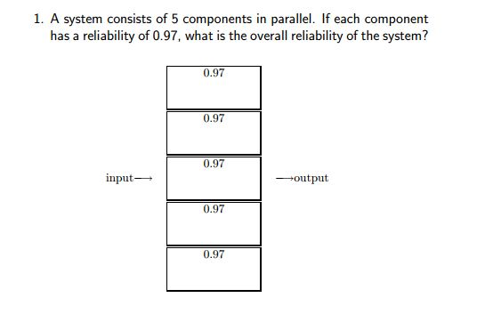
Reliability of a Parallel System
Ans: 99.99% (approximately 100%)

Slide 24
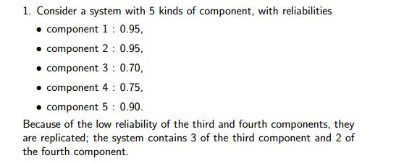
Reliability of a Combination System

Slide 25
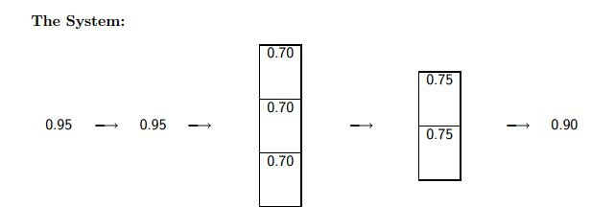
Reliability of a Combination System
Solution:
Reliability = .95 × .95 × (1 − .3 ^3 ) × (1 − .25^2 ) × .9
= 74.09%

Slide 26
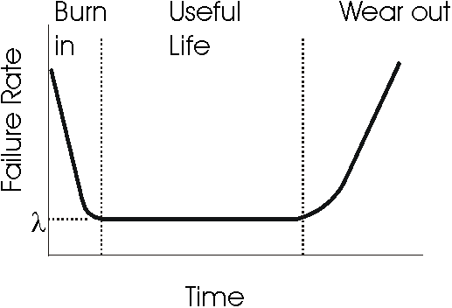
Reliability as a function of time (Bath Tub Curve)

Slide 27
Reliability as a function of time (Bath Tub Curve)
Over many years, and across a wide variety of mechanical and electronic components and systems, people have calculated empirical population failure rates as units age over time and repeatedly obtained a graph such as shown below. Because of the shape of this failure rate curve, it has become widely known as the "Bathtub" curve.
The initial region that begins at time zero when a customer first begins to use the product is characterized by a high but rapidly decreasing failure rate. This region is known as the Early Failure Period (also referred to as Infant Mortality Period, from the actuarial origins of the first bathtub curve plots). This decreasing failure rate typically lasts several weeks to a few months.

Slide 28
Reliability as a function of time (Bath Tub Curve)
Next, the failure rate levels off and remains roughly constant for (hopefully) the majority of the useful life of the product. This long period of a level failure rate is known as the Intrinsic Failure Period (also called the Stable Failure Period) and the constant failure rate level is called the Intrinsic Failure Rate. Note that most systems spend most of their lifetimes operating in this flat portion of the bathtub curve
Finally, if units from the population remain in use long enough, the failure rate begins to increase as materials wear out and degradation failures occur at an ever increasing rate. This is the Wear out Failure Period.

Slide 29


Reliability Calculation as a function of time
For the useful life portion of Bath Tub Curve:
Mean time between failures (MTBF): is the predicted elapsed time between inherent failures of a system during operation. MTBF can be calculated as the arithmetic mean (average) time between failures of a system.

Slide 30
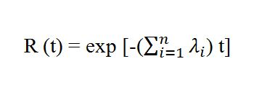
Reliability Calculation
Reliability of a component:
Reliability of a series system:
Earlier statistics show that a component has a failure rate of 0.07 per 1000 hours. Find out the probability that it will survive at least 5000 hours. Also find out the MTBF.
Ans: 0.7047 or 70.47%
MTBF of a Component = 1/λ

Slide 31
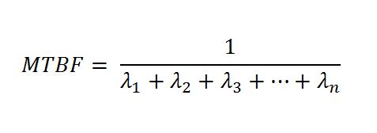
Reliability Calculation
A computer system has 4 components in series, with failure rates per 1000 hours given by 0.061, 0.048, 0.053 and 0.038. Find out the probability that the system will survive for at least 6000 hours. Also find out the MTBF of the system.
Ans: 0.3012 or 30.12%, 5000 hrs

Slide 32


Reliability of a Parallel System
For this part, we will assume that all the components connected in parallel have same failure rates.
If the failure rate is λ for all the components then reliability of the system is given by:
And, MTBF can be found using:

Slide 33
Reliability of a Parallel System
Failure rate of a component is 0.10 per 1000 hours. Find the MTBF for:
The individual component
When 2 of it are connected in parallel
When 3 of it are connected in parallel
When 4 of it are connected in parallel
Ans: 10,000 hours;15,000 hours; 18,333.33 hours; 20,833.33 hours

Slide 34
Reliability of a Combination System
A subassembly of a computer system consists of 3 components (A) in parallel and one component (B) in series. Reliabilities per 100 hour of A = 0.75 and B = 0.97.
Find the system failure rate and MTBF.

Slide 35
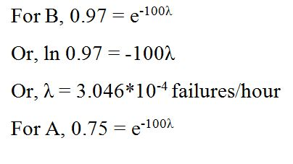
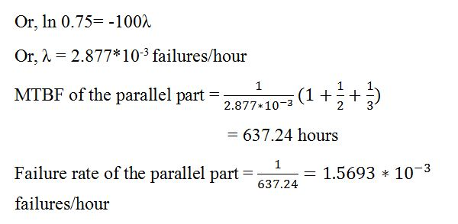
Solution

Slide 36
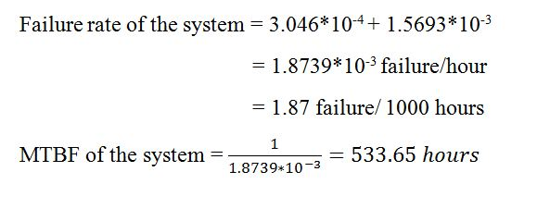
Solution

Slide 37


